Slide 1


MICROSOFT COPILOT AND EXCEL

Slide 2
COPILOT IN EXCEL CAPABILITIES

Slide 3

Module Agenda
Perform Exploratory Data Analysis using CoPilot and Excel
Data Sorting with CoPilot in Excel
Data Filtering with CoPilot in Excel
Color Coding Cells based on Conditions
Handling Missing Values
Perform Data Visualization with CoPilot
Generate Synthetic Data Using CoPilot
© All rights reserved for Dr. Ryan Ahmed @Stemplicity Inc.

Slide 4
CoPilot Capabilities in Excel
Natural Language Queries: Ask questions in plain language and get answers.
Data Insights: Quickly analyze trends and patterns.
Formula Assistance: Suggests and creates formulas.
Data Cleaning: Identifies errors and inconsistencies.
Trend Identification: Highlights key data trends and suggests visualizations.
Task Automation: Automates repetitive tasks like formatting and calculations.
© All rights reserved for Dr. Ryan Ahmed @Stemplicity Inc.

Slide 5
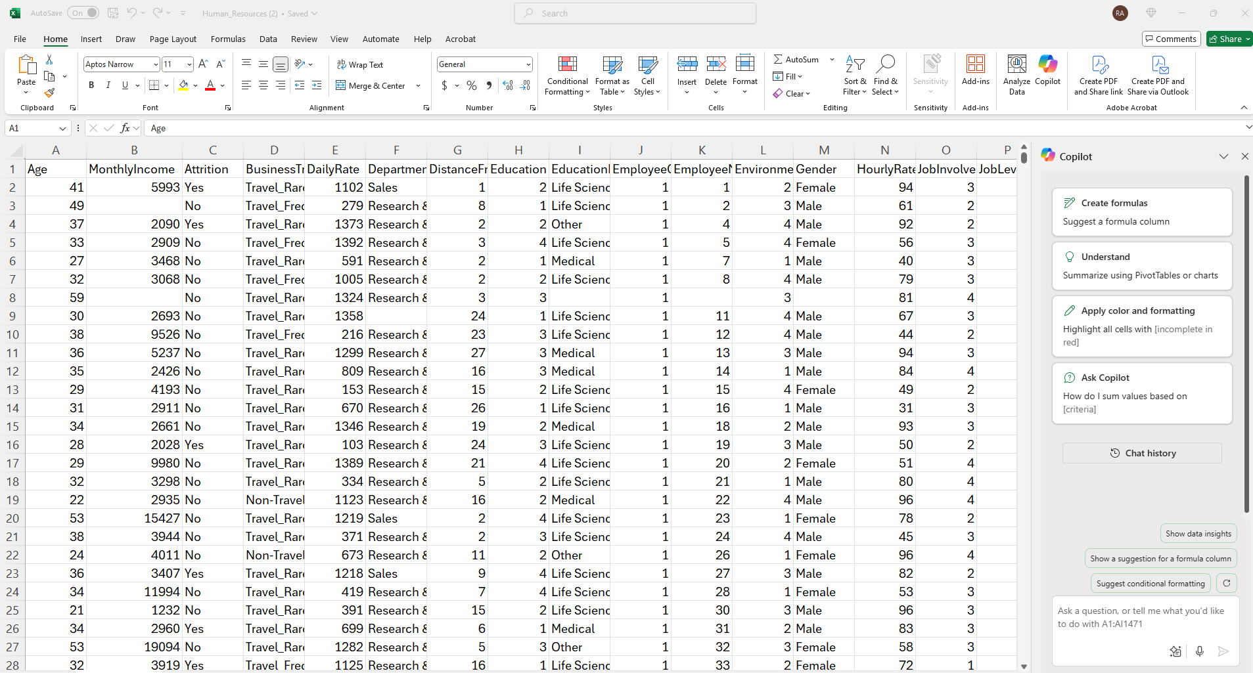
CoPilot Capabilities in Excel
© All rights reserved for Dr. Ryan Ahmed @Stemplicity Inc.

Slide 6
LIVE DEMO

Slide 7

Live Demo
🔗 Click here to explore CoPilot CoPilot Signup
💡 Click here for AI Prompts Explore Prompts
© All rights reserved for Dr. Ryan Ahmed @Stemplicity Inc.

Slide 8
Thank you!

